Slide 1
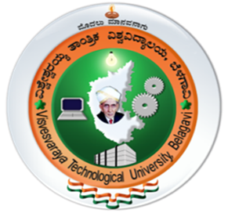

Department of Biotechnology THE OXFORD COLLEGE OF ENGINEERING Bommanahalli, Bangalore-560068. (VTU Affiliated, AICTE Approved and NBA accredited)
INTERNSHIP PRESENTATION ON:
Mindmatrix
Android App Development Using Generative AI
PRESENTED BY:
KIRTHI M HANGALLMATH(10X22BT012)
Internship Duration : 02-02-2026 TO 20-05-2026

Slide 2
INTRODUCTION
The internship focuses on Android App Development using Generative AI, which combines Artificial Intelligence techniques with mobile application development to create smart and efficient applications.
Generative AI is a modern technology that enables systems to generate content, automate tasks, and improve user interaction based on given inputs. Integrating this technology with Android development helps in building applications that are more intelligent and user-friendly.
The development of applications is carried out using Kotlin programming language, which is widely used for Android app development due to its simplicity and efficiency. The applications are built using Android Studio, which provides tools for designing, coding, testing, and debugging mobile applications.
This internship mainly focuses on understanding how AI can be applied in real-world mobile applications to enhance functionality, improve user experience, and support modern application requirements.

Slide 3
During this internship, I learned the fundamentals of Kotlin programming and its application in Android development. I gained practical knowledge of creating applications, designing user interfaces, and implementing application logic.
I developed skills in user interface design, including text formatting, background customization, and proper layout arrangement to ensure better readability and user experience. I also learned how to handle user input using input fields, implement button click events, and manage navigation between different screens within an application.
In addition, I understood how data is handled within applications, including capturing, processing, and displaying user information. I also explored basic concepts of authentication and security, such as login systems, to ensure safe access to applications.
Furthermore, I gained an understanding of how Generative AI tools can assist in application development, including improving design, supporting logic building, and enhancing overall efficiency. This internship provided a complete overview of developing mobile applications from basic design to functional implementation.

Slide 4

Company Overview
Organization:MindMatrix(Learning & Technology Platform)
Domain: AI, Android Development, Skill Training
Focus: Industry-oriented learning and internships
Key Features:
Hands-on project development
Mentorship and guidance
Real-world application learning
Structured internship programs
Mind Matrix is a technology and learning-based organization that focuses on providing AI-powered education and skill development programs. It aims to bridge the gap between academic knowledge and industry requirements by offering practical training and internship opportunities.
The company provides structured learning programs in areas such as Artificial Intelligence, Android App Development, and software technologies, helping students build real-world skills. It operates through a learning platform that includes mentorship, hands-on projects, and guided training.
Mind Matrix also supports students in becoming industry-ready by focusing on practical implementation, problem-solving skills, and project-based learning. It emphasizes the importance of combining knowledge with technical and professional skills to prepare learners for modern careers.

Slide 5
Team & My Role
Worked as an Android App Developer Intern
Collaborated with:
Mentors
Trainers
Fellow interns
Work Environment
Learning-oriented and supportive environment
Focus on:
Hands-on coding
Real-time project development

Slide 6
Internship Objectives
To understand the fundamentals of Generative AI and its applications
To learn Kotlin programming for Android application development
To gain practical experience in Android app development
Gain practical experience in Android app development
Learn and apply Kotlin programming fundamentals
Understand integration of Generative AI in mobile applications
Build real-world Android projects (AI Productivity App & Cupcake App)
To understand UI/UX design principlesTo learn event handling and input processing
To understand data handling and basic security concepts
To improve problem-solving and technical skills
Enhance self-learning, time management, and teamwork skills
To build a foundation for AI-based application development

Slide 7
Technologies Used
Kotlin – Programming language used for Android development
Android Studio – Main development environment used for building applications
Generative AI Tools – Used for understanding AI concepts and improving development
Salesforce Trailhead – Platform used for learning AI agents and workflows
Frontend Design – Text, background, and layout arrangement
Application Logic – Handling user interaction and functionality

Slide 8
TOOLS & PLATFORM
Development Environment: Android Studio.
Programming Language: Kotlin ,Java.
Learning Platform: Salesforce Trailhead .
AI Tools: Generative AI platforms.
Device: Android Mobile / Emulator.
INTERNSHIP WORKFLOW
Introduction to Generative AI concepts .
Learning Kotlin programming basics
Designing User Interface (UI)
Implementing user input and event handling
Developing Android application features
Planning and building a mini project (Financial Tracker App)

Slide 9
Key Projects & Deliverables
Project 1 : AI Productivity App
Developing a smart productivity application using Android
Integrating Generative AI concepts for task assistance
Focus on improving task management and user productivity
Project 2 : Cupcake Ordering App
Built an Android app for ordering cupcakes
Focused on understanding app navigation and UI flow
Helped in learning Android development fundamentals

Slide 10
PROJECT 3 : BIOSAGE HEALTH AI
BioSage Health AI
AI-Based Healthcare Assistant ApplicationIntroductionBioSage Health AI is an Android healthcare application prototype developed using Kotlin and Android Studio. The application is designed to provide a simple and user-friendly AI-assisted healthcare interface.
Objectives:
To develop a beginner-level healthcare Android application
To understand Android app development using Kotlin
To create a foundation for future AI-healthcare integration
Technologies Used
Kotlin
Android Studio
XML
Android

Slide 11
Novelty of the Project
Combines healthcare concepts with AI technology
Simple and beginner-friendly healthcare interface
Future scope for biotechnology and bioinformatics integration
Future Enhancements
AI chatbot
Symptom analysis
Personalized healthcare suggestions
Immunology and genomics integration
Database connectivity
Cloud-based healthcare monitoring

Slide 12
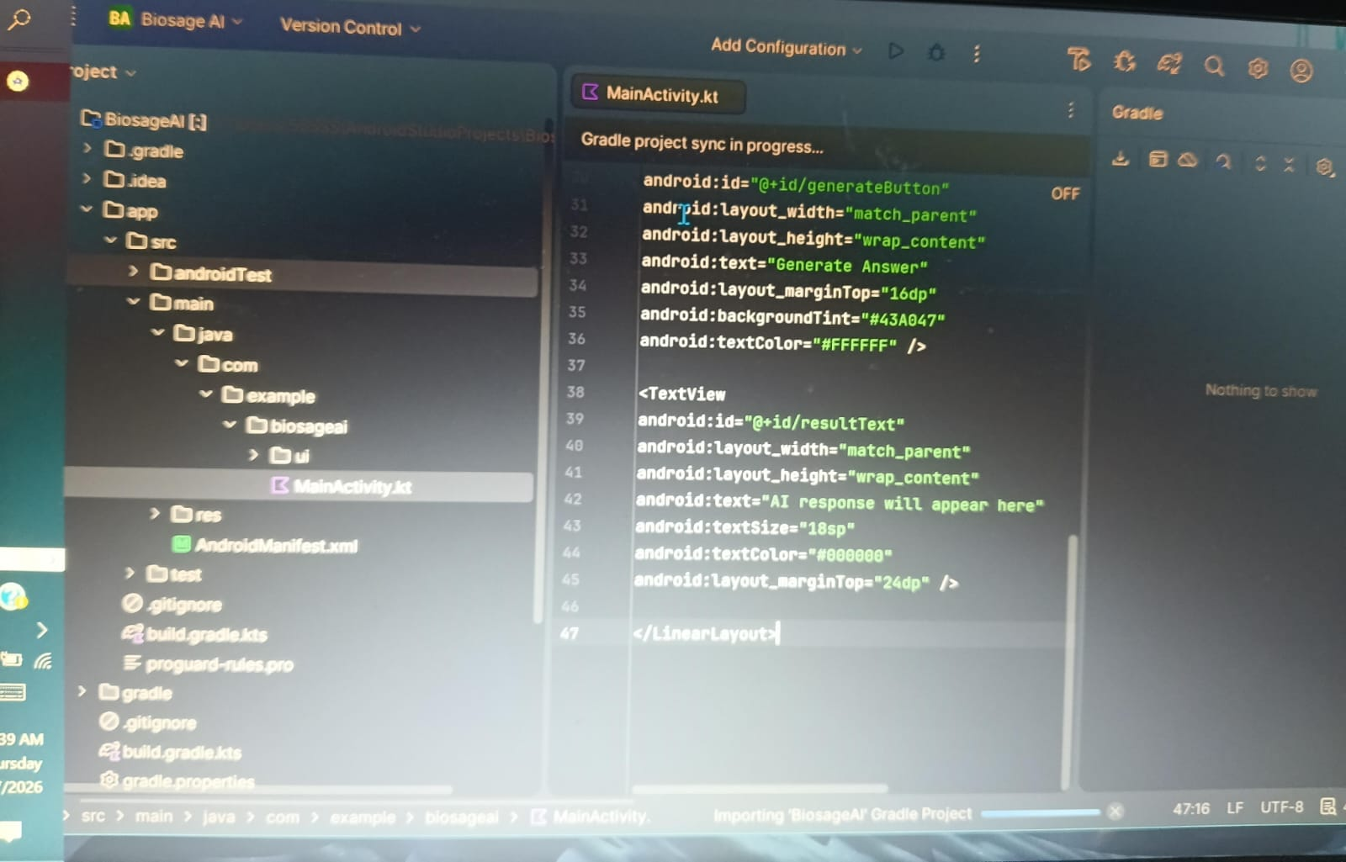
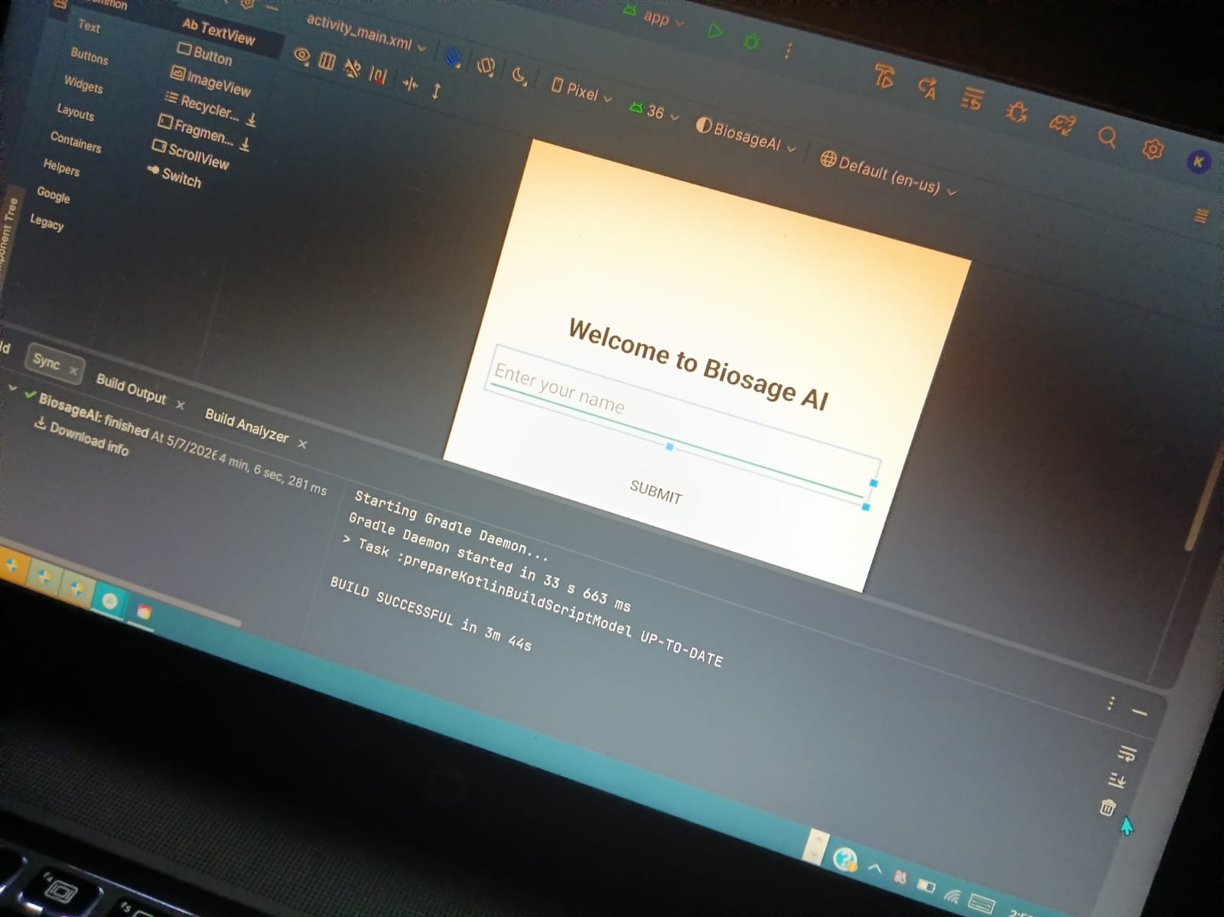
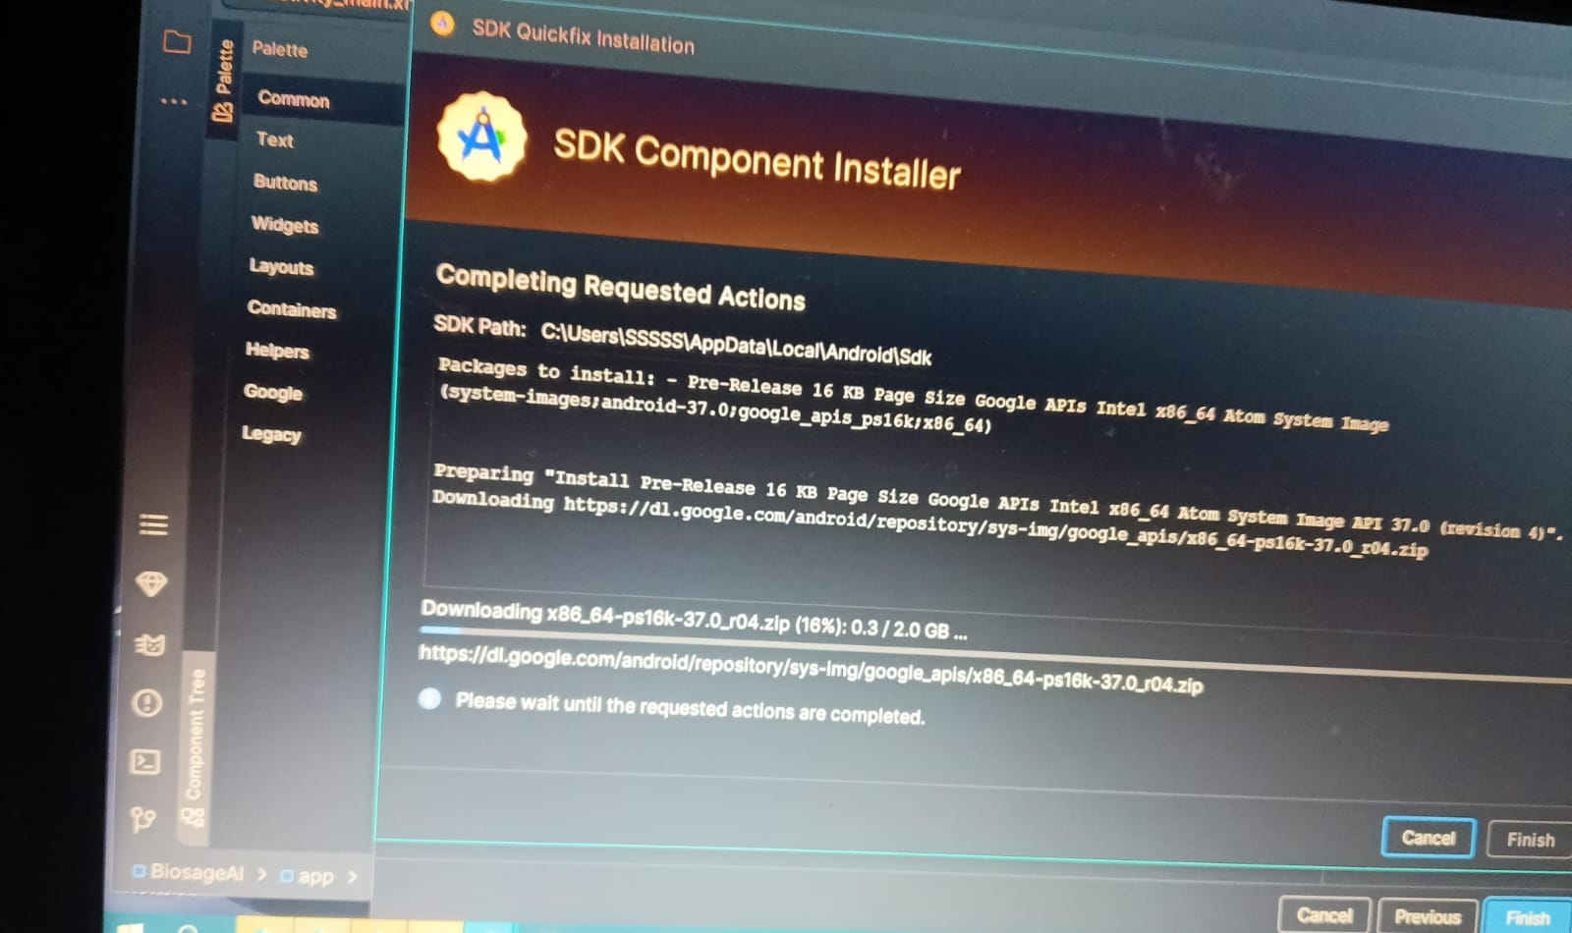
Fig 1: Android Studio Interface Showing UI Design and Build Execution of BioSage Health AI

Slide 13
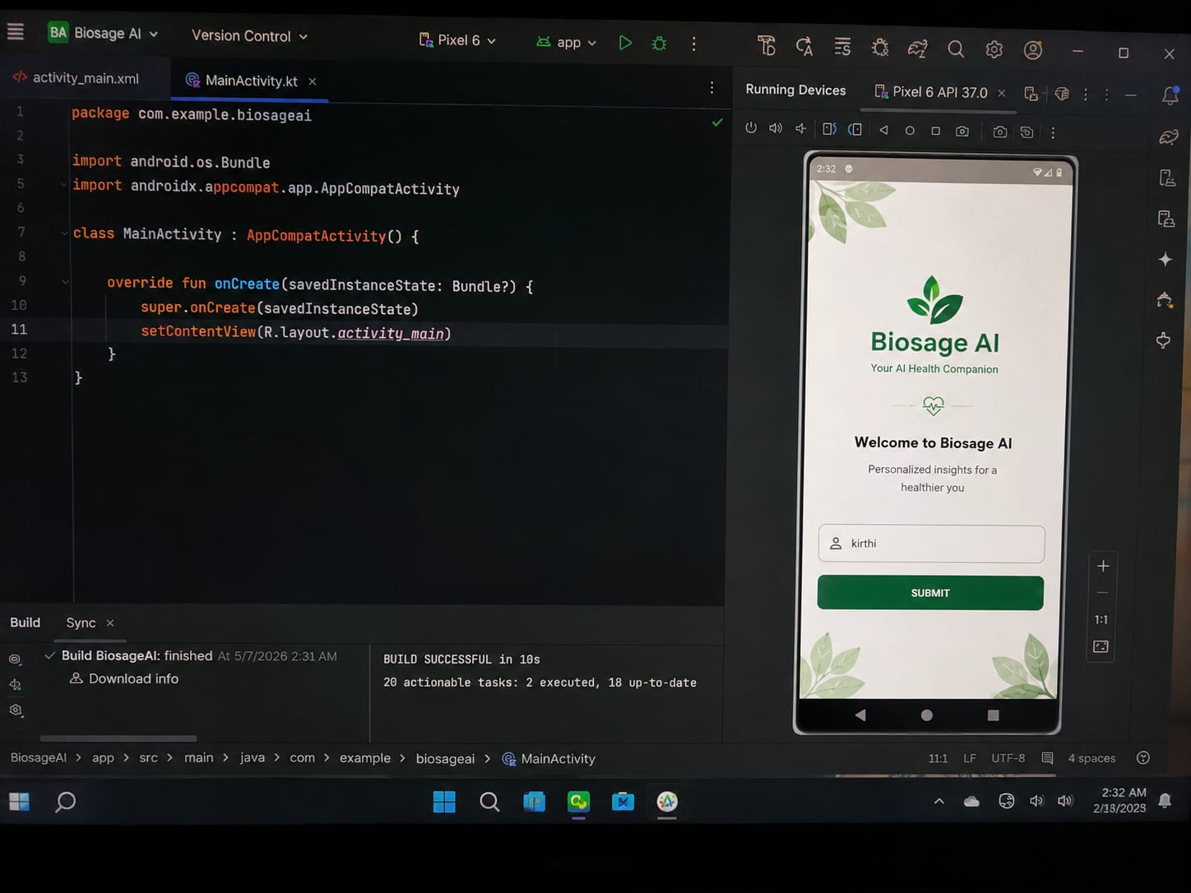
Fig 2:BioSage Health AI Android App Development

Slide 14
Android App Development using GenAI – Siri-Dhanya Hub (Agriculture)
Introduction
Android App Development using GenAI – Siri-Dhanya Hub (Agriculture)
Problem Statement
Karnataka is a major producer of millets (Siri-Dhanya).
Farmers do not know current market prices in different cities.
Consumers do not know recipes and health benefits of millets.
Vision
Siri-Dhanya Hub is a “Millet Value Chain” application that supports both farmers and consumers.
Main Features
Live mandi price tracking
Millet recipe guide
Health benefits information
Direct farmer connection
Technologies Used
Android Studio
KotlinX
MLGenAI
Concepts

Slide 15
Impact, Features & Conclusion
User checks millet prices
User explores millet recipes
User learns health benefits
User connects with farmers/FPOs
Impact Goals
Promote nutrition security
Encourage climate-resilient crops
Improve farmer prosperity
Increase millet awareness
Technical Implementation
Recycler View for price lists
Search bar for recipes
High-quality food images
Conclusion
Siri- Dhanya Hub is an AI-assisted Android application designed to connect farmers and consumers through millet awareness, market insights, recipes, and health education.

Slide 16
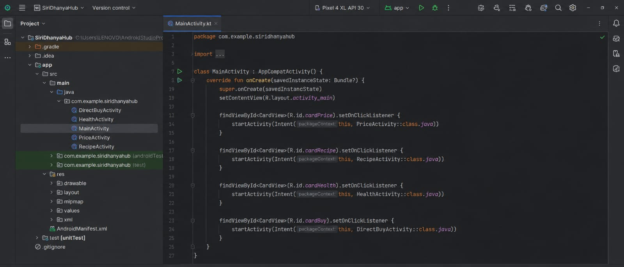
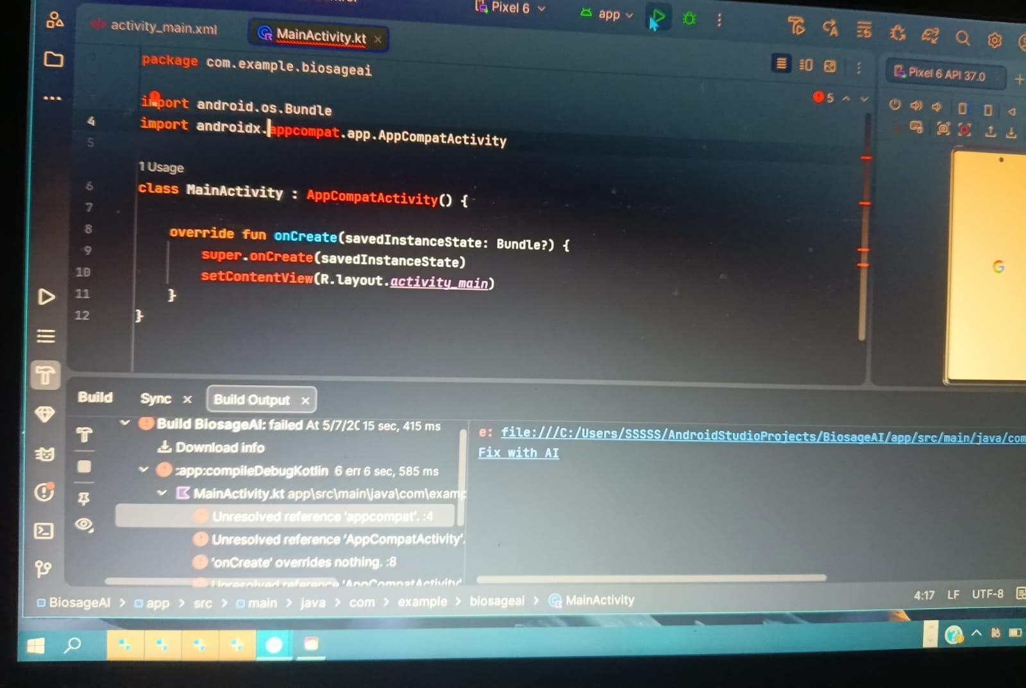
Fig 3: MainActivity Kotlin code implementation in Android Studio for Siri-Dhanya Hub application

Slide 17
Results, Challenges & Solutions
Results / Impact:
Successfully developed functional Android applications
Gained strong understanding of:
Android app structure
UI/UX design
AI-assisted development
Practiced through Google Codelabs
Solutions :
Practiced using Google Codelabs
Took guidance from mentors
Used AI tools for faster learning
Challenges Faced :
Understanding Android architecture
Learning Kotlin quickly
Applying AI concepts in mobile apps
Debugging errors

Slide 18
Conclusion & Future Impact
Conclusion :
The internship is currently ongoing and focused on practical learning
Successfully learned Kotlin fundamentals
Built initial Android projects:
AI Productivity App
Cupcake Ordering App
Biosage app
Gained exposure to AI-assisted development using tools like Google AI Studio and Antigravity
Future Impact :
Planning to enhance projects with advanced features and AI integration
Aiming to strengthen skills in:
Android Development
Generative AI applications

